Slide 1
Phishing Awareness Training

Slide 2
Presented by : Akbar Hussain

Slide 3
What Is Phishing Attack
Phishing is a type of social engineering and cybersecurity attack in which the attackers use malicious emails and advertisements similar to any authentic source to trap the targeted people.

Slide 4
Why is a Phishing Attack Performed?
Phishing attack is performed for various reasons some are:
1) Financial Gain: Attackers often aim to steal sensitive information of the victims to access the account numbers,credit card numbers and transactions And use all for their own financial benefits

Slide 5
2) Data Breaches: By obtaining the login credentials attackers breaches the sensitive data
3) Malware Distribution: Some Phishing attacks are performed to spread the malicious data. When the user downloads the malicious application that compromised the victim device and then can easily steal personal information.

Slide 6
Types of Phishing Attack
1) Spear Phishing
Spear Phishing targets the specific person , enterprise or companies and gains the deeper information of any employee. This is the most effective attack.

Slide 7
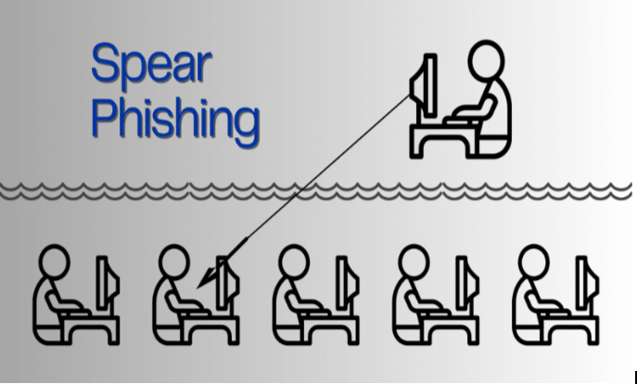

Slide 8
2) Vishing Attack
Vishing is a type of scam that uses phone calls to trick people into giving away their personal information. Scammers often use technology to make it seem like they are calling from a trusted source, like a bank or a government agency. They can create fake phone numbers that appear real, which leads people to think the call is legitimate.

Slide 9
These scams can happen entirely over phone calls, especially with the help of internet phone services (VoIP). Because VoIP allows scammers to disguise their phone numbers easily, people may feel more comfortable sharing sensitive info over the phone, mistakenly believing it's secure.

Slide 10
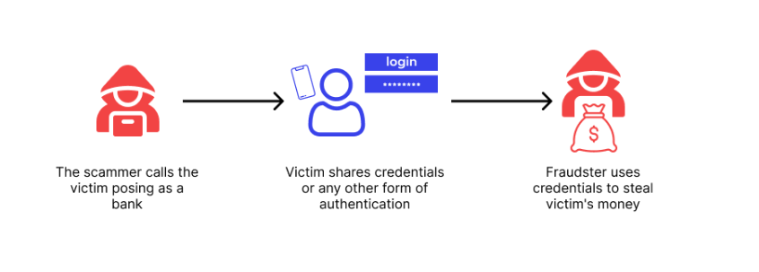

Slide 11
3) Smishing Attack
It is a Social Engineering attack that contains text, messages,or SMS . The text contains links to different webpages, phone numbers or email addresses. When someone clicks it automatically it opens a new web browser, dial phone number or email messages. This causes the user to fall on this malicious activity.

Slide 12
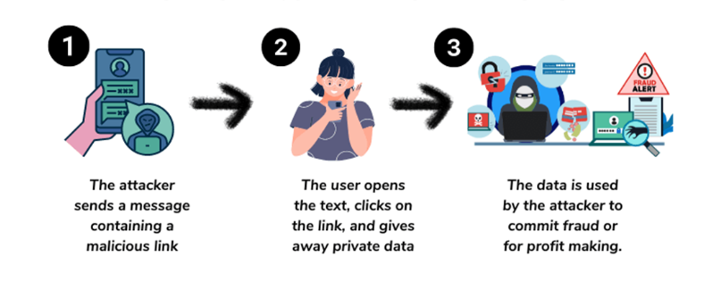

Slide 13
How to Recognize Phishing And Social Engineering Attempts
1) Email Addresses
Check the sender's email address closely. Phishing emails often have addresses that look very similar to real ones. Look out for spelling mistakes or extra characters

Slide 14
2) Examine Content
Phishing attempts often have spelling and grammar mistakes and use generic greetings. They tend to create a sense of urgency and ask for sensitive information. Always verify the legitimacy of such messages before responding.

Slide 15
3) Verify the Hyperlinks
Always hover over links in emails to see where they really lead. Be careful with shortened URLs—they might go to harmful sites. Legitimate organizations will use secure connections, indicated by "https://".

Slide 16
4) Urgency and Threats
Watch out for emails that pressure you to act quickly or threaten serious consequences. Real messages usually don't rush you.

Slide 17
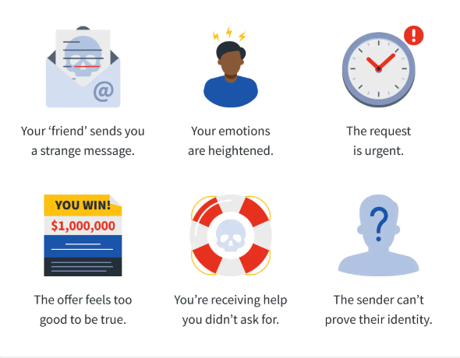
Social Engineering Tactics

Slide 18
How to Protect Yourself Against Phishing and Social Engineering?
1) Educate Yourself and Friends
Stay updated on the latest phishing tricks and social engineering methods. Share this information with your colleagues, friends, and family to raise awareness and help everyone stay safe.

Slide 19
2) Use Multi-Factor Authentication
Enable Multi- Factor Authentication whenever possible. This adds an extra layer of security, making it more difficult for attackers to gain unauthorized access.

Slide 20
3) Use Security Software
Use trusted antivirus and anti-phishing software to spot and stop harmful activities. Regularly update all your software and security systems to stay protected.

